Slide 1
Inflation, rate hikes, volatility: Managing interest rate risk in 2022
May 2022

Slide 2
Learning Objectives
1
Understand the current market environment and its impact on hedging strategies
2
Learn strategies corporate finance teams are employing to manage interest rate risk

Slide 3
Disclaimer
22-0131

Slide 4
Today’s speaker
Carissa Burns
Carissa leads the Southeast Client Relationship team. Prior to Chatham, she worked in the fintech sector at both ICD and Reval, helping corporations and financial institutions automate their treasury and risk management operations. She graduated summa cum laude from Converse College with a degree in Mathematics and Economics.
Director
Corporates
+1 484.731.0061
cburns@chathamfinancial.com

Slide 5
Chatham overview
Unequalled expertise that spans industries
Chatham Financial delivers financial risk management advisory and technology solutions to organizations across industries and around the world — helping companies maximize value in the capital markets.
3,000+ clients globally
Corporations
Real Estate
More than $6.6 trillion hedged notional since 1991
Over 600 employees
7 global offices
Financial Institutions
Private Equity and Infrastructure

Slide 6
Access advantage
Integrated advisory, operations, and technology for financial risk
Partnership that propels you forward - Chatham partners with your team, leveraging a unique mix of advisory, operational capabilities and technology so you can manage risk better and take advantage of opportunities.
Hedging
Operations
Accounting
Solutions for FX, Interest Rate, and Commodity Risk:
Hedging advisory
Hedge execution
Hedge accounting & valuations
CHATHAMDIRECT™ for treasury risk management
Derivatives compliance
ISDA advisory
Strategic advisory
Operational capabilities

Slide 7
Agenda
Interest rate market update
Interest rate hedging strategies
Advanced interest rate hedging strategies
Interest rate risk mitigation in practice

Slide 8
Market update
Federal Reserve expectations
Inflation
The labor market
Economic growth
The Fed expects the Personal Consumer Expenditures (PCE) index to average 4.3% for 2022, up from the prior 2.6% projection.
By 2023, the Fed expects inflation to abate and core PCE to average 2.6%. PCE Inflation is still expected to be 2% over the longer run.
For reference, core PCE was 5.2% in March.
The Fed expects the labor market to be robust in 2022.
Maintained its 3.5% unemployment expectation by year end, which would be a 53-year low.
In April, unemployment claims hit their lowest level in 53 years multiple times.
The Fed’s expectation of US economic growth worsened.
The Fed projects US GDP to increase by 2.8% this year, down from the prior 4% estimate.
The decrease can be attributed to increased rate hike expectations, the general labor shortage, COVID, and geopolitical tensions.
Meeting Date | 100-125 | 125-150 | 150-175 | 175-200 | 200-225 | 225-250 | 250-275 | 275-300 | 300-325 | 325-350 | 350-375 | 375-400 | 400-425 | 425+ | Implied market # of total hikes
Jun-22 | 12.9% | 87.1% | 0.0% | 0.0% | 0.0% | 0.0% | 0.0% | 0.0% | 0.0% | 0.0% | 0.0% | 0.0% | 0.0% | 0.0% | 4.9
Jul-22 | 0.0% | 0.3% | 14.4% | 85.3% | 0.0% | 0.0% | 0.0% | 0.0% | 0.0% | 0.0% | 0.0% | 0.0% | 0.0% | 0.0% | 6.9
Sep-22 | 0.0% | 0.0% | 0.1% | 7.3% | 49.9% | 42.7% | 0.0% | 0.0% | 0.0% | 0.0% | 0.0% | 0.0% | 0.0% | 0.0% | 8.4
Nov-22 | 0.0% | 0.0% | 0.0% | 0.1% | 5.8% | 40.9% | 44.2% | 9.0% | 0.0% | 0.0% | 0.0% | 0.0% | 0.0% | 0.0% | 9.6
Dec-22 | 0.0% | 0.0% | 0.0% | 0.0% | 0.1% | 5.3% | 37.5% | 43.9% | 12.4% | 0.9% | 0.0% | 0.0% | 0.0% | 0.0% | 10.7
Feb-23 | 0.0% | 0.0% | 0.0% | 0.0% | 0.0% | 2.0% | 16.9% | 39.8% | 32.5% | 8.2% | 0.6% | 0.0% | 0.0% | 0.0% | 11.3
Mar-23 | 0.0% | 0.0% | 0.0% | 0.0% | 0.0% | 0.6% | 6.3% | 23.6% | 37.7% | 25.5% | 6.0% | 0.4% | 0.0% | 0.0% | 12.0
May-23 | 0.0% | 0.0% | 0.0% | 0.0% | 0.0% | 0.4% | 4.3% | 17.5% | 32.7% | 29.8% | 12.9% | 2.4% | 0.1% | 0.0% | 12.4
Jun-23 | 0.0% | 0.0% | 0.0% | 0.0% | 0.0% | 0.3% | 2.9% | 12.9% | 27.4% | 30.8% | 18.7% | 6.0% | 0.9% | 0.0% | 12.7
Jul-23 | 0.0% | 0.0% | 0.0% | 0.0% | 0.0% | 0.2% | 2.6% | 11.5% | 25.4% | 30.3% | 20.4% | 7.7% | 1.6% | 0.3% | 12.8
Note: The dark blue boxes indicate the market’s expectation of the federal funds rate at a given point in time.
Rates data as of May 5, 2022
Notes:
Next PCE reading comes out tomorrow, March 31.

Slide 9
Market update: Interest rates
Rates data as of May 5, 2022

Slide 10
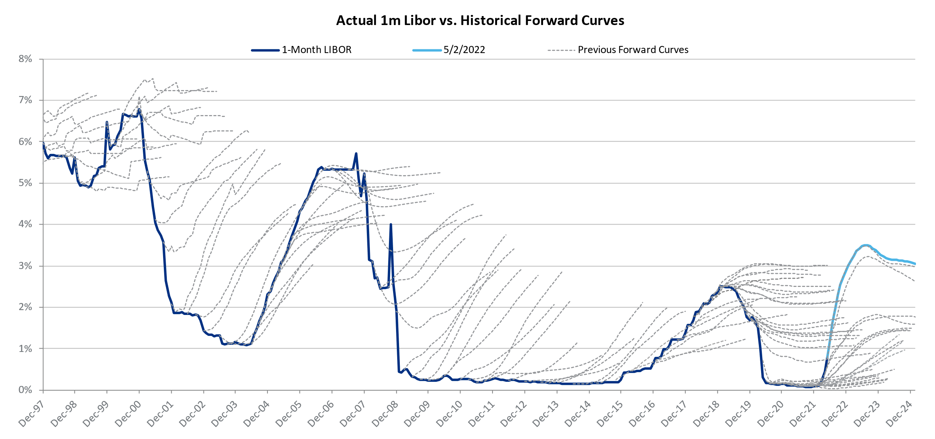
Market update: Interest rates
Rates data as of May 2, 2022

Slide 11
Interest rate hedging strategies

Slide 12
Interest rate swaps
Lock in at-market prices to eliminate upside and downside
Purpose
Key economics
Cash flows
Effectively makes a floating rate loan into a fixed rate loan.
Term, notional, interest periods, swap rate.
No upfront premium (zero value at inception).
There is always a payment made by one party to the other.
Hedge provider
Fixed: swap rate
Company
Lender
Floating: LIBOR
Spread
Floating: LIBOR
Swap
Loan

Slide 13
Interest rate swaps
Lock in at-market prices to eliminate upside and downside
Swap rate indications
 | 2-year | 3-year | 4-year | 5-year | 6-year | 7-year
Swap 1m LIBOR to fixed | 2.85% | 2.91% | 2.90% | 2.89% | 2.88% | 2.89%
Swap 1m Term SOFR to fixed | 2.71% | 2.78% | 2.78% | 2.76% | 2.76% | 2.76%
Rates data as of May 5, 2022
Advantages
Disadvantages
Removes uncertainty
No out-of-pocket upfront cost
Usually hedge accounting friendly
No “upside” participation
Hedge can be a large liability
Requires credit

Slide 14
Interest rate caps
Pay a premium to preserve upside
Purpose
Key economics
Cash flows
Effectively “caps” (or puts a ceiling on) floating interest rate payments.
Term, notional, interest periods, strike rate.
Cap purchaser pays an upfront premium.
Each “caplet” generates a payout if the index exceeds the strike rate.
Hedge provider
Premium ($)
Company
Lender
Floating: LIBOR
Spread
LIBOR
- cap strike
Cap
Loan

Slide 15
Interest rate caps
Pay a premium to preserve upside
Cap premium indications (per $100mm notional)
Cap strike | 2-year | 3-year | 4-year
3.0% | $1,122,000 | $2,061,000 | $3,012,000
3.5% | $794,000 | $1,556,000 | $2,347,000
4.0% | $581,000 | $1,207,000 | $1,876,000
4.5% | $441,000 | $967,000 | $1,541,000
5.0% | $348,000 | $796,000 | $1,299,000
Rates data as of May 5, 2022
Advantages
Disadvantages
Certainty of worst-case result
Preserves “upside” participation
No credit required unless premium is deferred
Premium requires cash outlay
If rates move in your favor, realized upside can be reduced by the amount of premium paid

Slide 16
Interest rate collars
Pay a premium to preserve upside
Purpose
Key economics
Cash flows
Creates a finite range in which rates may float.
Term, notional, interest periods, strike rate.
No upfront cost (premiums net to zero).
Make payments if rates remain low and receive payouts if they rise.
Hedge provider
Floor strike
- LIBOR
Company
Lender
Floating: LIBOR
Spread
LIBOR
- cap strike
Collar
Loan

Slide 17
Interest rate collars
Use multiple products to create a custom band of outcomes
Zero-cost collar indications
3-year | 2-year | Premium
Cap strike | Put strike | Cost
3.5% | 2.6% | $ -
4.0% | 2.4% | $ -
Rates data as of May 5, 2022
Advantages
Disadvantages
Certainty of best and worst-case result
Allows fluctuation within a chosen tolerance
Can be structured in a way that requires no out of pocket cost
Limits “upside” participation
Less “downside” protection than forward
Hedge can be a large liability
Can present pricing inefficiencies

Slide 18
Advanced interest rate hedging strategies

Slide 19
Pre-issuance hedging
Hedging interest rate risk of future fixed rate issuance
Recent market developments
Many companies plan to issue fixed rate debt in the future which introduces the potential coupon to the risk of Treasury yields rising between today and the issuance date
Treasury yields, particularly on the medium/long-term end of the curve can be subject to large swings over a few months time
Hedging strategy corporations are considering
Enter into a forward starting swap or treasury-lock today to protect against movements in interest rates between today and the anticipated future bond issuance date
Pre-issuance hedging: Enter into a swap that effectively locks in the Treasury component of the anticipated future issuance today
Structure the trade with a mandatory early termination (MET) event aligning with the anticipated future issuance date. The settlement of the trade will offset fluctuations in interest rates which will have impacted the bond coupon
Today,
Enter into hedge
1 year,
Issuance date
11 years,
Maturity date
Exposed to fluctuations in interest rates
In 1 year: Rates increase more than expected
Rates decrease more than expected
Bond issuance rate increases more than anticipated
Bond issuance rate decreases more than anticipated
Hedge becomes an asset, and the hedge settlement is an inflow for the company
Hedge becomes a liability, and the hedge settlement is an outflow for the company

Slide 20
Receive-fixed swaps
Swapping fixed rate debt to floating
Receive-fixed swap
Recent market developments
Company
Fixed swap rate: 3.0%
Bank
The forward curve has steepened considerably on the front end and flattened on the medium/long term through the first quarter of 2022 as rate hike expectations for the second half of 2022 and 2023 rose considerably
Floating: LIBOR
2.10%
Spread
Hedging strategy corporations are considering
Receive-fixed swap: Enter is a swap to pay a floating rate plus a spread and receive a fixed swap rate in order to gain interest rate pickup in the short-term, at the expense of the term-term, dependent upon the slope
Increased relevance for companies looking to match liabilities with assets

Slide 21
LIBOR transition update

Slide 22
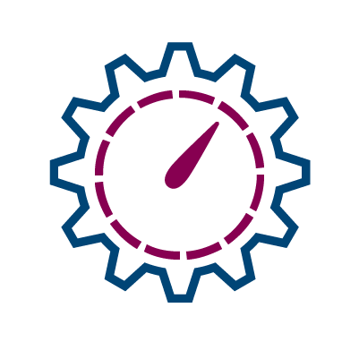
LIBOR - SOFR transition
Current status
Some ongoing LIBOR derivatives activity on legacy LIBOR debt; liquidity may diminish as 2023 approaches
Most new debt origination is on SOFR
Various versions of SOFR are emerging; term SOFR liquidity still limited
Action items
Understand SOFR trigger events in both debt and derivative markets
Understand future action items: whether/when to proactively convert LIBOR derivatives to SOFR
Calculating SOFR in arrears, rate is set at the end rather than the beginning of period, etc.
Companies should be aware of the nuances of various SOFR alternatives and their application in debt vs. derivatives
Reference Rate | Rate set timing | Reference period | Includes rate compounding | Derivatives liquidity | Additional notes
Daily Simple SOFR | End of accrual period | In arrears, references current period | No | Yes | Second in ARRC fallback language waterfall for loans
SOFR Compounded | End of accrual period | In arrears, references current period | Yes | Yes (used by banks for interdealer trades) | ISDA fallback rate for derivatives (plus credit spread adjustment)
NY Fed Avg. SOFR | Beginning of accrual period | In arrears, references prior period | Yes | Yes | Common in real estate loans but less so for corporate borrowing
CME Term SOFR | Beginning of accrual period | In arrears, references prior period | No | Emerging | First in ARRC fallback language waterfall for loans

Slide 23
LIBOR – SOFR transition
SOFR timeline and trends
SOFR Transition
LIBOR extinguishes June 30, 2023
Some ongoing LIBOR derivatives activity on legacy LIBOR debt; liquidity may diminish as 2023 approaches
Majority of debt origination is on SOFR
Various versions of SOFR are emerging; term SOFR liquidity still limited
Weekly SOFR trade count has fully surpassed LIBOR, and LIBOR transaction volume has lost steam
Chatham is permanently switching to SOFR discounting by May month end
Source: ISDA.org

Slide 24
LIBOR – SOFR transition
Understanding SOFR fallback spreads
SOFR fallback spreads
The ISDA defined fallback of 11.6bps established a benchmark for derivatives markets
Forward-looking spreads have differed somewhat from this (see chart)
Credit-spread-adjustments (CSAs) may or may not be appropriate in a debt agreement
SOFR floor implications
Understand whether a SOFR floor includes a quoted spread or not
Derivative and hedge accounting implications as well
1y
2y
3y
4y
5y
6y
7y
Hedge Tenor | 1y | 2y | 3y | 4y | 5y | 6y | 7y
SOFR-LIBOR Spread | 31 bps | 5 bps | 11 bps | 13 bps | 14 bps | 14 bps | 10 bps
Market data as of 5/3/2022

Slide 25
Interest rate risk mitigation in practice

Slide 26
Interest expense analysis: Model assumptions
Key model assumptions
Interest expense modeled under various fixed-to-floating ratios, over the 5-year time period from May 31, 2022 to May 31, 2027
Debt modeled
Constant $300mm credit facility until 05/31/2027
Loan bears interest on 1m LIBOR plus a borrow spread of 2.50%
Hedged modeled
Swaps modeled to target 50%, 70%, and 90% hedged
Caps to target 50% and 70% hedged
Trades are indexed to 1m LIBOR
Period Start Date | Term Loan balance | Swap to target 50% fixed | Swap to target 70% fixed | Swap to target 90% fixed | Cap to target 50% fixed | Cap to target 70% fixed
May 2022 | 300,000,000 | 150,000,000 | 210,000,000 | 270,000,000 | 150,000,000 | 210,000,000
May 2023 | 300,000,000 | 150,000,000 | 210,000,000 | 270,000,000 | 150,000,000 | 210,000,000
May 2024 | 300,000,000 | 150,000,000 | 210,000,000 | 270,000,000 | 150,000,000 | 210,000,000
May 2025 | 300,000,000 | 150,000,000 | 210,000,000 | 270,000,000 | 150,000,000 | 210,000,000
May 2026 | 300,000,000 | 150,000,000 | 210,000,000 | 270,000,000 | 150,000,000 | 210,000,000
May 2027 | 300,000,000 | 150,000,000 | 210,000,000 | 270,000,000 | 150,000,000 | 210,000,000

Slide 27
Interest rate curves
Rates data as of May 5, 2022

Slide 28
Interest expense scenarios
Targeting various fixed/float ratios by layering on swaps
Interest expense is modeled under different shocked forward curves (+/- 1-2 standard deviations) for each hedging strategy.
For example, in the ‘Unhedged’, under the current forward curve, the company could expect a total of $82mm of interest expense from their USD debt over the period May 2022 – May 2027, equivalent to a 5.41% effective interest rate.
The swap rates for the following schedule is 2.91%.
Rates data as of May 5, 2022

Slide 29
Case study: Mitigating interest rate risk and optimizing hedge execution
A medical equipment company seeking to determine their ideal capital structure mix and execute hedges in order to achieve the desired risk reduction, attaining best pricing at execution while rewarding important banking relationships.
Company goals
Determine ideal fixed/floating capital structure mix to align with peers and achieve increase interest rate risk objectives as inflation remains elevated and Fed rate hikes expectations continue to escalate
Execute hedges: balancing rewarding bank relationship while achieving competitive pricing
Key activities
Quantified hedging impact of various strategies against multiple future interest rate scenarios.
Created peer analysis comparison to inform target hedge ratio.
Worked with counterparties to negotiate hedge pricing and reduce overall transaction costs prior to trading.
Executed hedge transactions within company’s preferred timeline, ensuring competitive live pricing.
Results
Provided quantitative risk analysis and peer capital structure analysis to allow company to make an informed decision to meet risk mitigation objectives.
Executed on defined hedging structure, ensuring efficient and transparent hedge pricing.
Total interest expense
Forward curve w/ ± 1 & 2 standard deviation bands
 | Current profile |  | Swap $250mm (80% Fixed)
New swap rate locked in | - |  | Swap rate: 2.00%
 | Effective rate | Interest expense | Effective rate | Interest expense
Rates move +2 SD | 6.62% | $ 194.3mm | 5.67% | $ 166.4mm
Rates move +1 SD | 4.38% | $ 128.6mm | 4.11% | $ 120.7mm
Rates follow fwd curve | 3.37% | $ 99.1mm | 3.39% | $ 99.5mm
Rates move -1 SD | 2.34% | $ 68.6mm | 2.64% | $ 77.6mm
Rates move -2 SD | 2.01% | $ 59.2mm | 2.44% | $ 71.5mm
Additional details
$250M pay-fixed swap, split capacity across 4 counterparties
Negotiation credit/execution charges prior to savings which amounted to approximately $250K
Reduced ‘worse-case’ interest expense by $28mm over a 4-year period

