Slide 1

Faster Payments Update
Sims Propst, SVP
South State Bank
Gary B. Nesbitt, AAP
GNesbitt Consulting

Slide 2
South State Overview
SouthState Bank was recently awarded 16 top categories in the regional and middle market space by the Greenwich Coalition42.
Recognized by Forbes as #30 in List of Top 100 Largest Banks in America
58th largest bank in the nation
Serving the financial needs of customers and communities since 1934
$42 Billion in asset
Over 5000 employees
Over 300 branches and ATMs in Florida, Alabama, Georgia, North Carolina, South Carolina and Virginia

Slide 3
GNesbitt Consulting
Independent consulting firm specializing in banking and payment activities and issues.
Our goal is to help financial institutions and companies understand and comply with myriad payment rules and regulations that govern the payments landscape.
We help organizations understand and mitigate the risks associated with participating in the various payment systems.
We help organizations establish payment programs that are efficient, effective and compliant with all appropriate rules and regulations.

Slide 4
Agenda
  A Definition of FASTER payments
  Real-time or near real-time options
    What came out of the Faster Payments Task Force
    RTP
    Zelle
    Card Network Options
  Same-day ACH
    Where we are now
    Other ACH changes
  FedNow
  Where do we go from here??

Slide 5
Definition of Faster Payments
Does it mean Real-Time?
Sometimes – but then what is real time? 5 seconds, 30 seconds, a minute, five minutes, etc.
In the end the question is, what’s fast enough for you and your company’s needs?
Same-day ACH is a “Faster Payment” but it’s not real-time, just faster than it used to be
Check image is MUCH faster than paper delivery, so you can call check a faster payment as well

Slide 6
What is the Faster Payments Task Council?
An industry-led membership organization whose vision is a world-class payment system where Americans can safely and securely pay anyone, anywhere, at any time and with near-immediate funds availability.
FPC encourages a diverse range of perspectives
Open to all stakeholders in the U.S. payment system.
Goal is to resolve the issues inhibiting broad faster payments adoption in this country.
Participants include financial institutions, technology providers, industry groups, fintechs, consumer groups and corporations.

Slide 7

Real Time Payments
RTP is a payment rail, not a product.
Started in 2013 by The Clearing House, supported by Vocalink (UK)
First LIVE transaction occurred in Nov. 2017, with focus on B-to-B
Growth is slow, started with a few big banks connected
FIS and Jack Henry offer the service to their clients (banks, credit unions) which has increased the number of FIs that can participate
https://www.theclearinghouse.org/payment-systems/rtp
Update - Just increased the single item limit to $1,000,000 to match Same Day ACH limit

Slide 8
Real Time Payments
Key Features:
  Credit push - irrevocable
  Request for Credit
  ISO 20022 – global compatibility
  Robust messaging
  Immediate Transaction acknowledgement
  Real-time payments
  24/7/365 processing and settlement
  Integrated tokenization and directory services (use of alias’s supported)
  FI’s can be receive only or send & receive

Slide 9
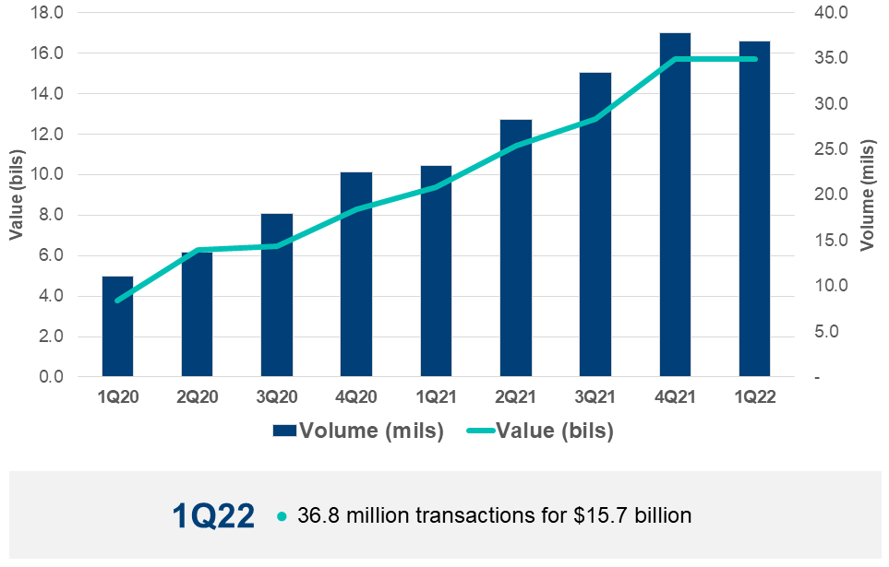
RTP Current Activity

Slide 10

Zelle
Owned by Early Warning Systems (EWS) which is owned by 7 large banks
Rolled out 2018 by a number (about 50) of large banks and credit unions.
Now in more than 1,000 banking apps
2021 volume 1.8 billion payments for $490 billion
Primary focus – Person to person (P-to-P); greater focus on business cases this year
Key features:
  Near real-time if the two F.I.’s signed up with Zelle
  Use phone number, email rather than R/T # and Account Number
  Will use the debit card rails for outside of network entries
  Credit push network

Slide 11
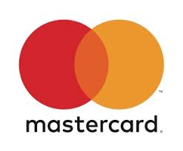

VISA and Mastercard
The networks are working together, somewhat
“VISA Direct” & “Mastercard Send” are the products
Deposit based products – so credit push like RTP
Sold as a P-to-P solution or a funds disbursement solution (corporate – for reimbursements, refunds, rebates, payouts, etc.)
Near real-time – instant payments to all eligible US debit cards or prepaid cards
Leverages Visa/Mastercard payment security systems

Slide 12

Other Faster Payment Options
Primary focus is on P-2-P Solutions
  PayPal
  FI owned (Chase QuickPay)
  Popmoney
  Venmo
Social media affiliated platforms,
Perhaps Twitter due to recent Musk involvement
(Mostly P-2-P via mobile)
Are any of these truly real-time or even same-day?

Slide 13
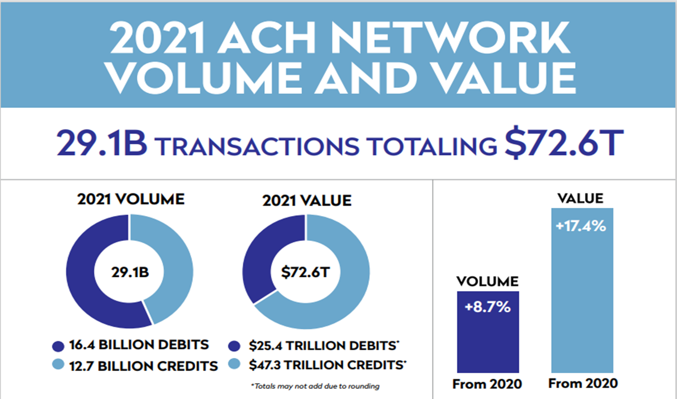

Slide 14
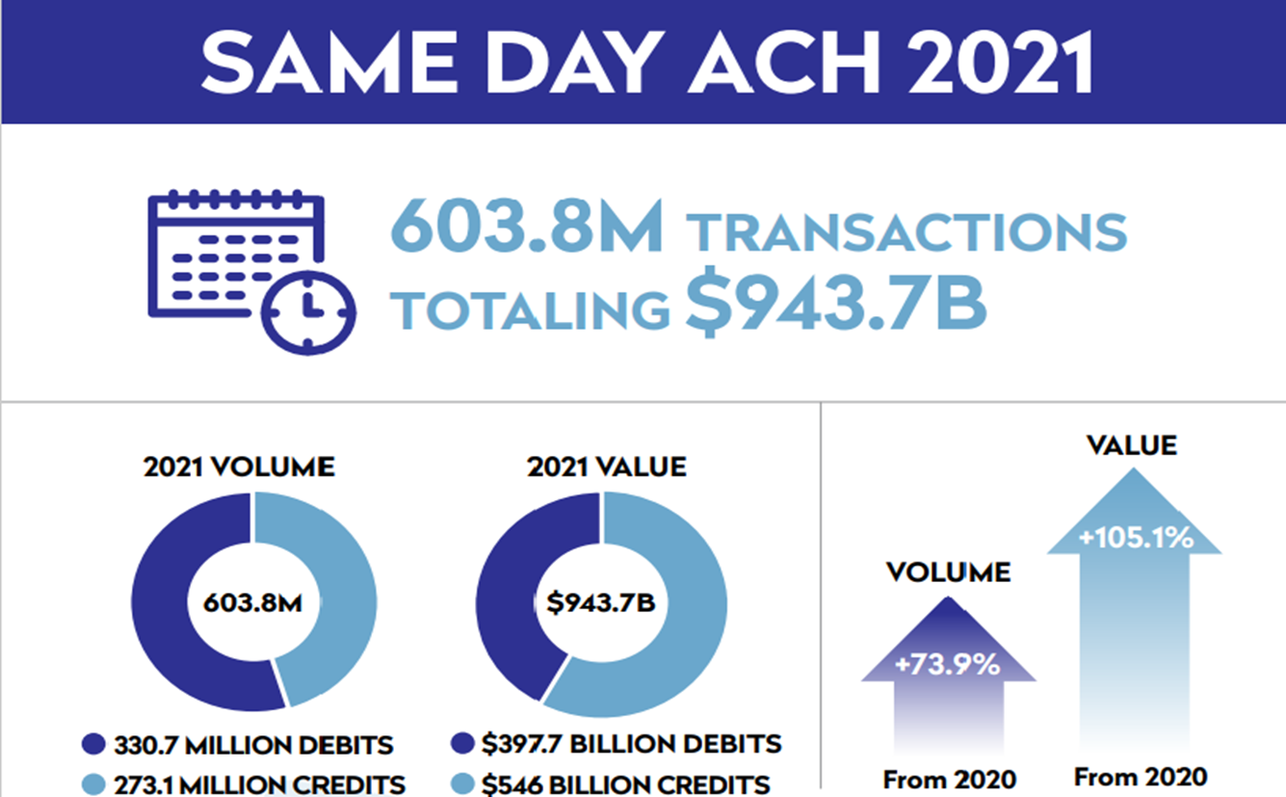

Slide 15
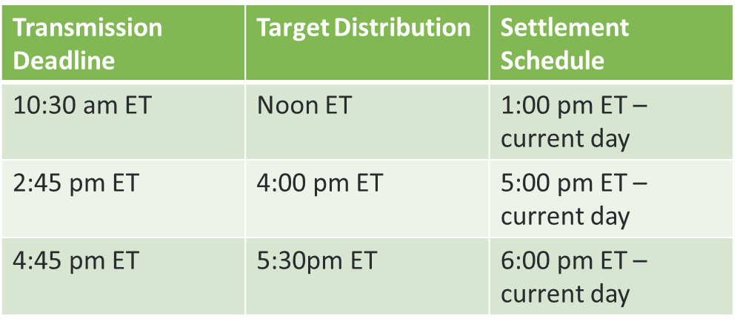
Same Day ACH Processing Windows

Slide 16
Expanding Settlement Times
The Fed had to move back settlement times for Fedwire and Net Settlement services to accommodate the later Same Day ACH windows
RDFI’s are required to make funds available for this window until the close of business.

Slide 17
Increasing the Dollar Limit
Past Dollar limit - $25,000
NEW Dollar limit - $1,000,000 EFFECTIVE March 19, 2022
Positives:
  Can run balanced files with the offset up to $100,000
  Can process larger transactions, generally good for the business to business market
  More transactions can run same-day when needed
Negatives:
  COULD have large dollar transactions hitting your account late in the day when funding is an issue

Slide 18
What Is FedNow?
A new instant payment service being developed by the Federal Reserve Banks.
Goal is to enable all financial institutions to provide safe and efficient instant payment services in real time, 365 days a year.
Businesses and individuals will be able to send and receive instant payments conveniently
Recipients will have full access to funds immediately, giving them greater flexibility to manage their money and make time-sensitive payments.
FedNow Service will provide choices in the market for clearing and settling instant payments as well as promote resiliency through redundancy.

Slide 19
FedNow
August 2020 Fed announced the features and functionality of this system.
Projected to launch in 2023 – phased approach for financial institutions. Will use the ISO 20022 standards and formats
It will be a credit push payment model but will have “request for payment” features.
https://www.frbservices.org/financial-services/fednow/about.html#timing

Slide 20
NACHA’s API Standardization Efforts
Efforts began in 2017
Group includes banks, credit unions, processors and software developers
Several ongoing initiatives to help standardize these processes
https://www.nacha.org/afinis-interoperability-standards

Slide 21
Where Do We Go From Here?
Monitor, read, talk to peers and watch
Ask customers about expectations when it comes to payments – not just faster payments
Review internal business cases, whether FI or Company, to determine where a faster payment makes sense - Cost/benefit will be part of the equation
Real-time payments WILL be a reality – the REAL question is when!

Slide 22
Questions?
Contact Information
sims.propst@southstatebank.com
(864) 751-9029
gary.nesbitt@gmail.com
(704) 609-4309
  LinkedIn: http://www.linkedin.com/in/garynesbitt/

Slide 23
Thank You

